Slide 1
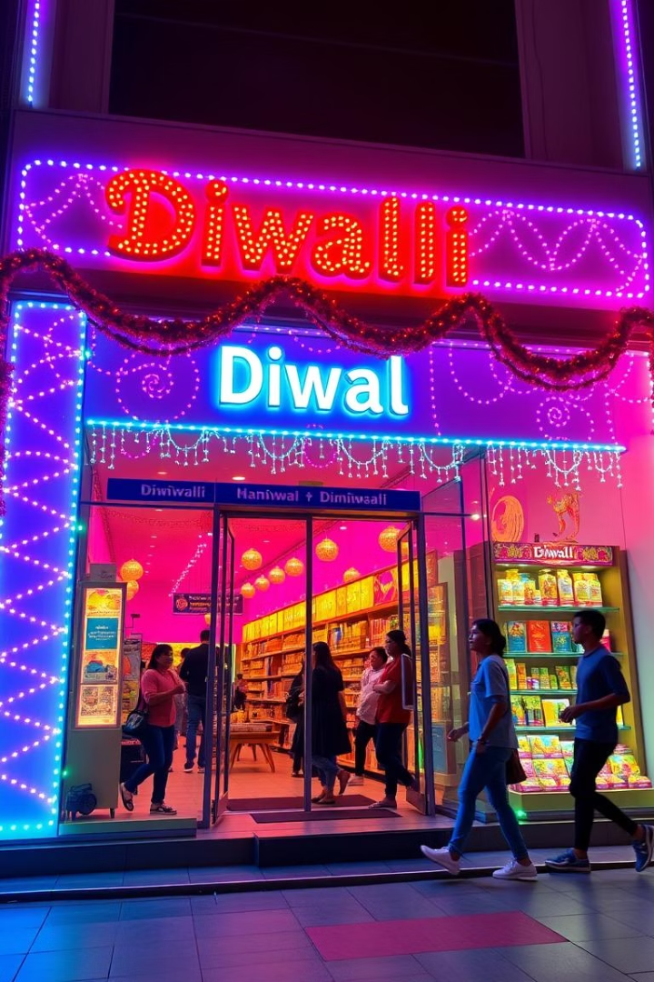
🔍 AtliQ Mart Promotion Performance Analysis
Diwali 2023 & Sankranti 2024 Campaign Review
Presented by: Rohanur Rahman
Date: [May 14 2025]

Slide 2

Project Overview
Objective
Analyze campaign effectiveness to guide future promotions
Scope
Store-level performance
Promotion-type effectiveness
Product & category insights
Executive ad-hoc analysis

Slide 3
Data Overview
Datasets Used
Metrics Derived
Sales Events (fact_events)
Incremental Revenue (IR)
Promotion Details (dim_campaigns)
Incremental Sold Units (ISU)
Product Metadata (dim_products)
% Increase in Sales Units
Store Locations (dim_stores)
Revenue Per Unit

Slide 4
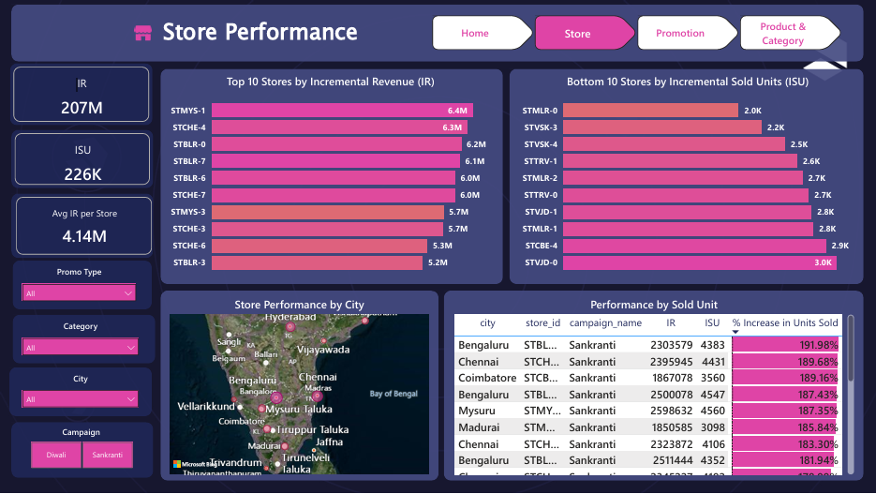


Slide 5
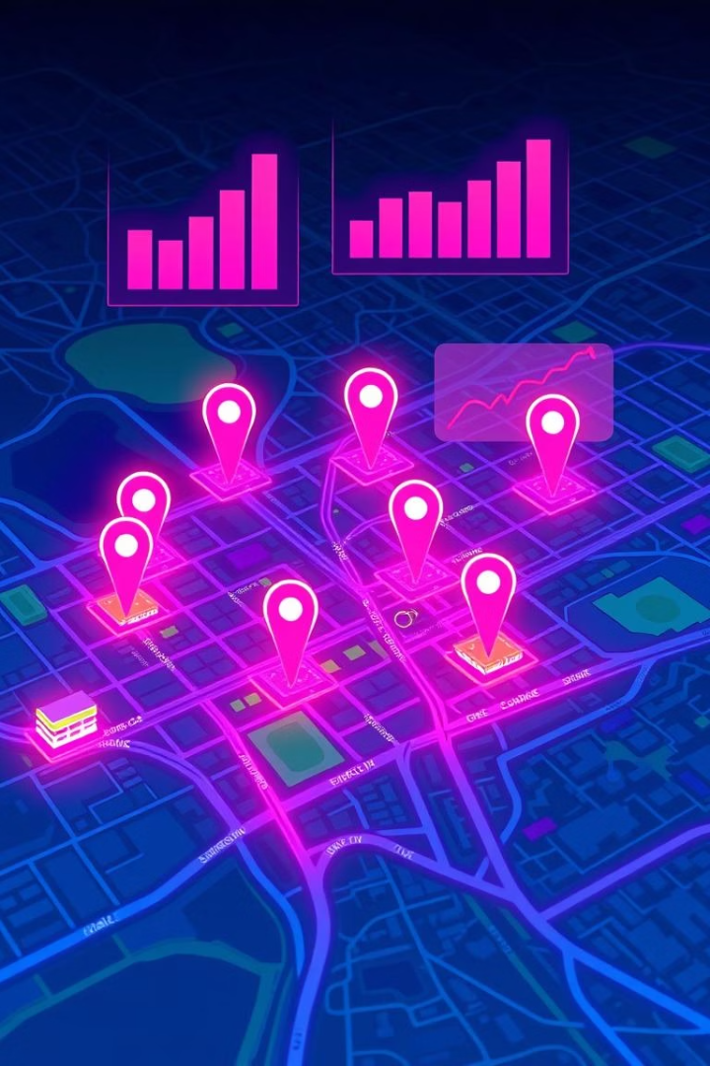
Store Performance Insights
Top 10 Stores by IR
Bottom 10 Stores by ISU
Highest IR approx ₹6.4M at STMYS-1
Lowest ISU around 2.0K units at STMLR-0
City-Level Trends
Bengaluru, Chennai, Mysuru led sales during Sankranti

Slide 6
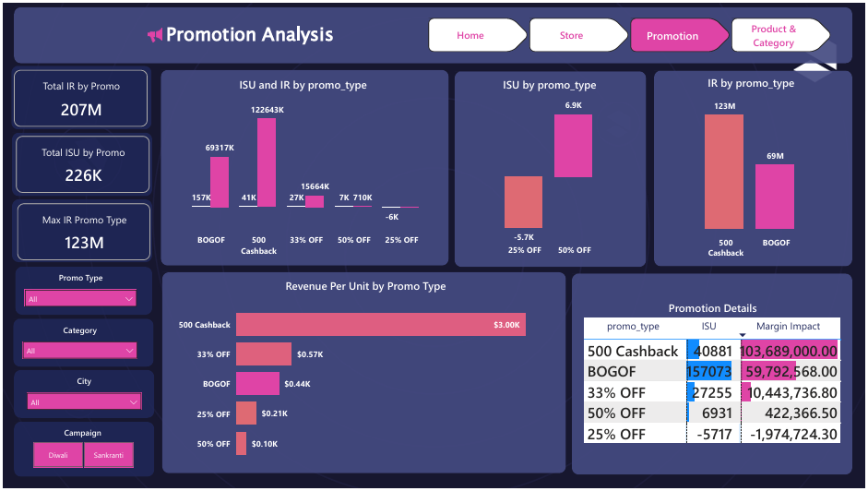

Slide 7
Promotion Type Effectiveness
Top by Incremental Revenue
Bottom by ISU
Discount vs Value
₹500 Cashback: ₹103M
25% OFF: Negative ISU -5717
Value-based promotions outperform percent discounts
BOGOF: ₹69M
50% OFF: ISU 6931
Cashback offers best IR-ISU balance

Slide 8
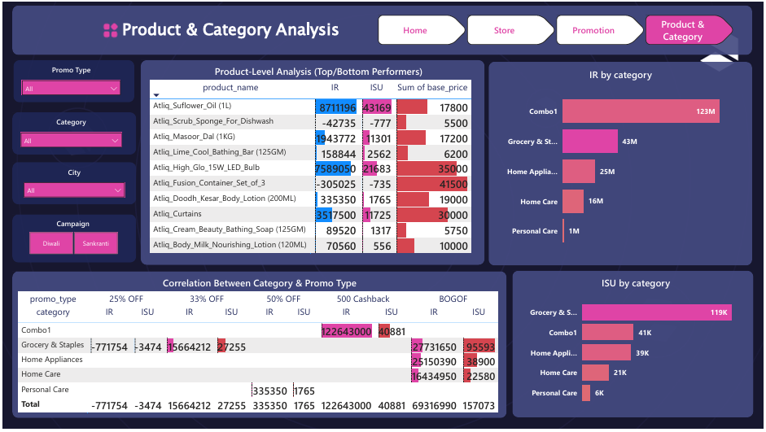

Slide 9
Product & Category Analysis
Top Categories by ISU
Top Products
Underperformers
Grocery & Staples ~119K units
Atliq Sunflower Oil (1L): 43K units
Atliq Scrub Sponge: Negative IR & ISU
Combo Packs ~41K units
Atliq LED Bulb: ₹7.6M incremental revenue
Fusion Container Set: Low sales, high price

Slide 10
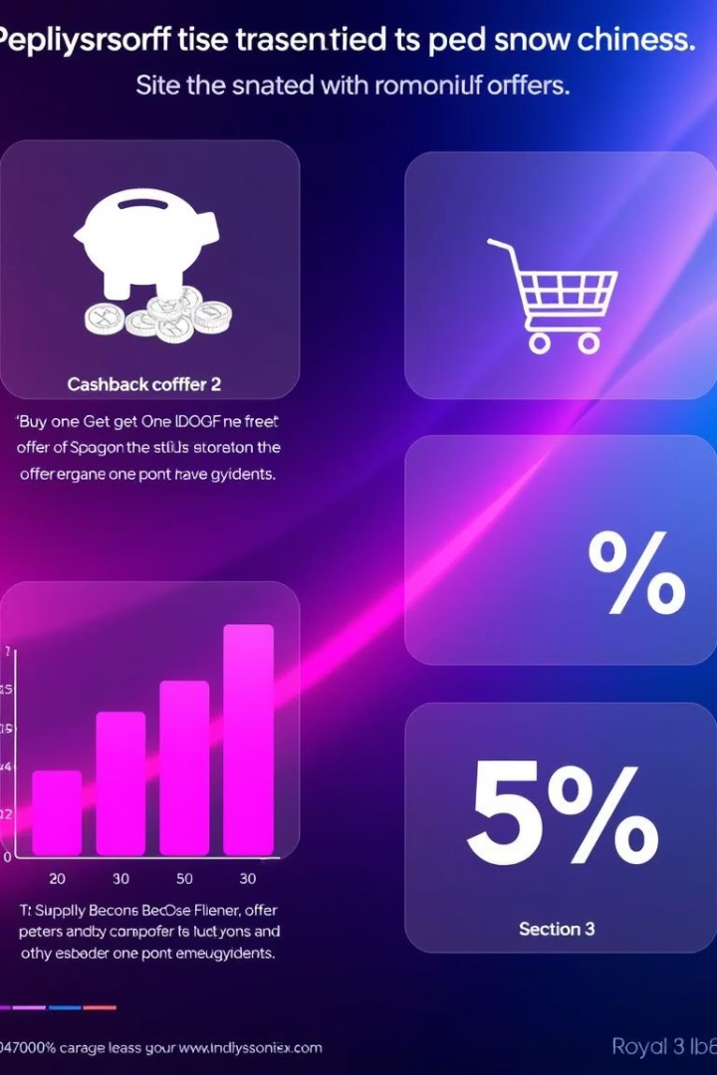
Promotion-Type x Category Correlation
Combo1 Packs
Dominated under Cashback promotions
Grocery Staples
Responded well to 33% OFF & BOGOF
Home Appliances
Most benefited from BOGOF offers
Strategic Takeaway
Match promotions to category responsiveness

Slide 11
Executive Summary
What Worked
What Didn't
₹500 Cashback & BOGOF led returns
High % discounts hurt margins
Combo packs, grocery staples performed well
Some SKUs underperformed despite promos
Strong city performance: Bengaluru, Chennai

Slide 12

Recommendations
Campaign Focus
Cashback & BOGOF on high-demand SKUs
Store Strategy
Replicate successful Mysuru, Chennai model
Review underperforming stores like STMLR-0
Product Strategy
Discontinue or redesign poor performers
Promote winners via value offers

Slide 13

Thank You

